Slide 1


Slide 2
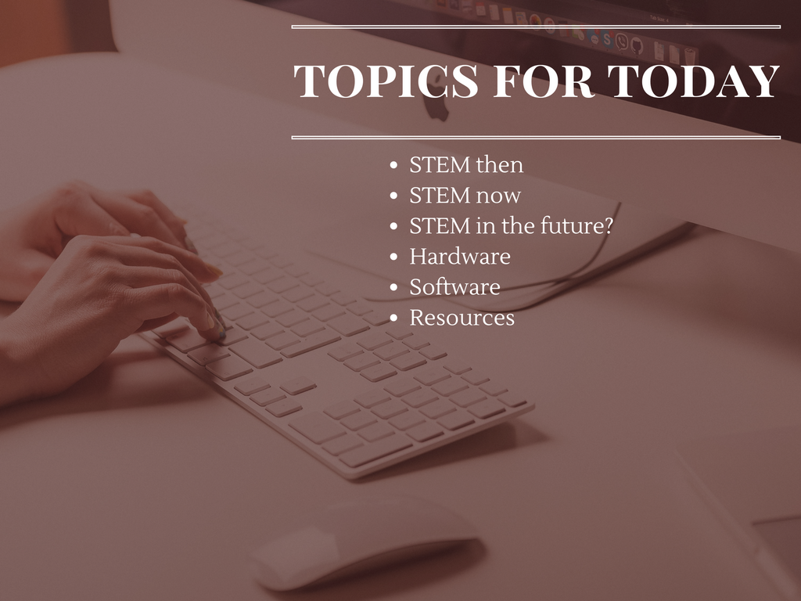
Notes:
So, what’re we going to talk about this morning?
These topics. Why? Because standing up here for an hour and pelting you with review after review of websites or example after example of weekend experiements is not something you need. You know how to Google. What we will be doing is looking at STEM’s history a bit, where we are right now in related fields, and how we’re going to prepare our children for the jobs of tomorrow.
Then, after that, we’ll look at some hardware you can get to spark new interest or maintain current interest in a variety of STEM areas.
Then, some software options and various resources you can use because I’d be remiss if I didn’t share some with you.
So please, at any time, just speak up if you have something to add or a question and I’ll do my best to answer or at least help you find that answer if I don’t know it.

Slide 3

Notes:
Before we get started, just a little about me.
I’m part of the Educational Technology faculty at the University of Arizona.
I received my Ph.D in Instructional Technology from Ohio University.
I’ve been involved in research with entities like Google, the company that makes Pokemon Go, and most recently am part of a $1.5 million grant from the Department of Education.

Slide 4

Notes:
STEM! What does it mean?
STEM, as you likely know, stands for Science, Technology, Engineering, and Mathematics. It's a catch-all for the occupational sector in which those jobs reside. And yes, if you think it's a bit of a buzzword... it is.
I personally prefer STEAM, the A representing the Arts, but, as you probably know, there’s practically no money to be made in theater unless you’re Andrew Lloyd Weber, so STEM it is.

Slide 5
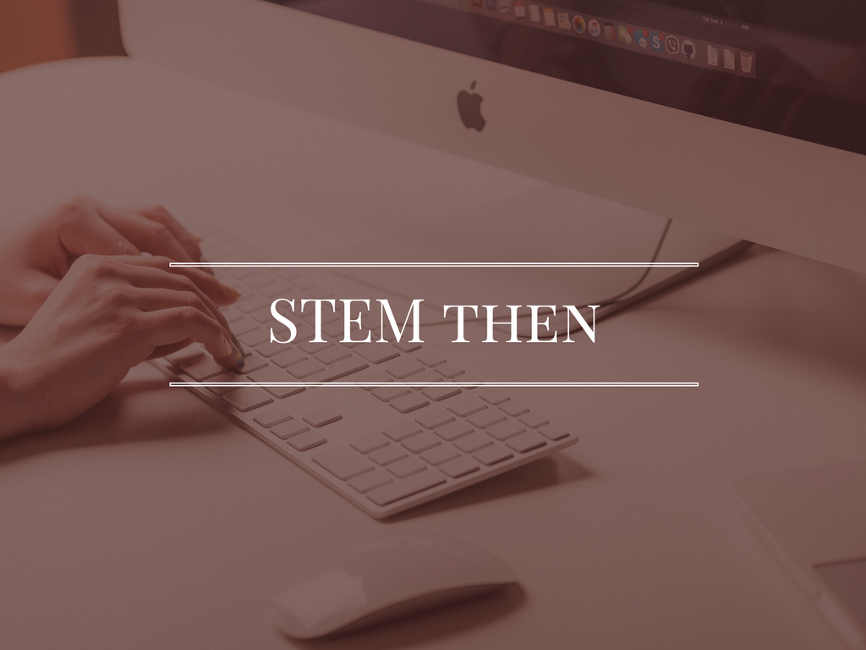
Notes:
So let’s look at the history of STEM so we know where we’ve been, which lets us know where we’re going.

Slide 6
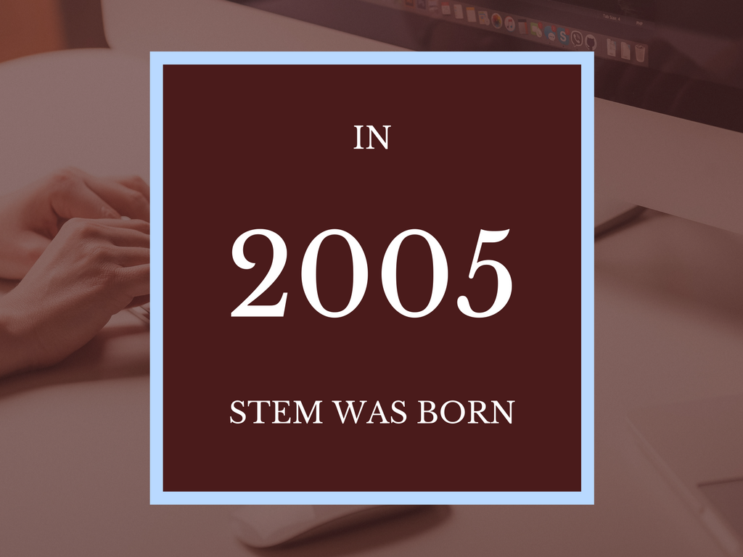
Notes:
History of STEM
Popped up in 1985
Policy piece that referenced need to determine "whether recent initiatives to improve education in mathematics, science, engineering, and other technology-related subjects are likely to meet the country's needs." http://www.edweek.org/ew/articles/1985/01/30/05080008.h04.html
A reference pops up in a 2000 Texas plan to allocate "345 million to increase federal student-loan forgiveness for students who major in science, math, technology, or engineering and commit to teach in a high-need school for at least five years." http://www.edweek.org/ew/articles/2000/07/12/42camnote.h19.html
But the first mention of "STEM" wasn't until 2005 when a bipartisan couple of representatives "set up the Science Technology Engineering and Math, or STEM, caucus" in Congress (which is still there, by the way).
And the rest, as they say, is history.

Slide 7
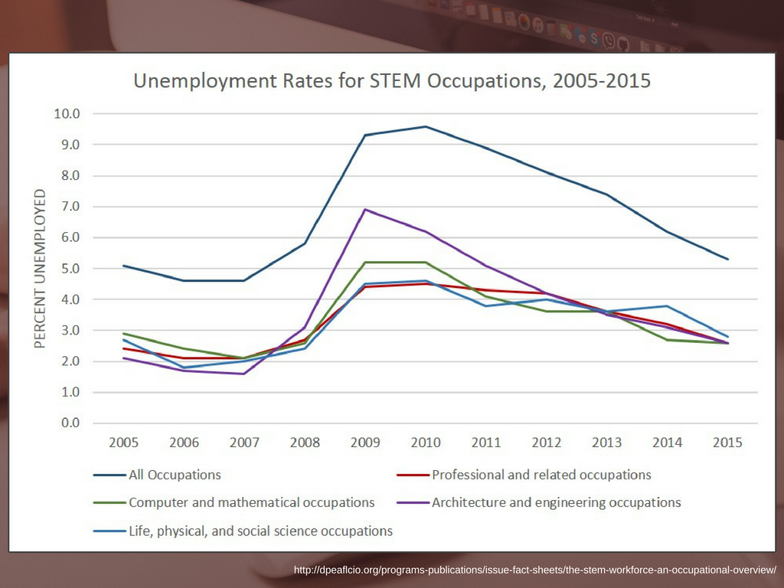
Notes:
Unemployment graph
So if we say that STEM as we know it began in 2005, we can trace how jobs in that sector have changed over time and compare them to the rest of the general employment, nationally.
After all, we want our children to do things they love in fields that they can find success in. So, where’s the data that says STEM fields are good for them? Here we are.
What we find is that jobs in those sectors have not only consistently done nearly twice as well at maintaining their viability over the past ten years, but have recuperated from the recession almost to their original level (and in Computer and Mathematical Occupations it's even improved since 2005).

Slide 8

Notes:
That brings us to STEM now.
Where are the jobs now? How did people prepare for the jobs they have now?

Slide 9
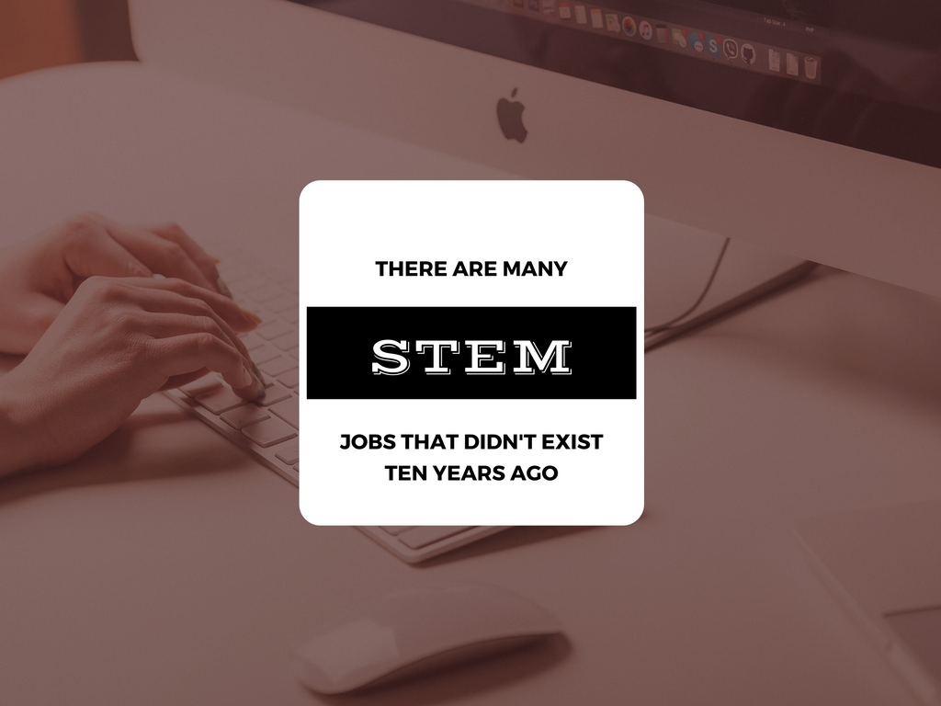
Notes:
There are many STEM jobs that didn't exist 10 years ago. Here are some numbers from Monster.com http://www.monster.com/career-advice/article/jobs-that-did-not-exist
(Five slides with jobs and median salaries)

Slide 10

Notes:
Analyzes data about websites to identify problems and opportunities. Then helps clients latch on to those and fix problems or take advantage of opportunities.
So: data collection, data review, setting up action plans.

Slide 11

Notes:
Can vary in job skills widely depending on the client, but there are some essential skills: expert knowledge of programming languages, experience with development tools and environments, and a deep understanding of mobility in terms of the communication landscape and the affordances that come with mobility.

Slide 12

Notes:
Looks for ways to reduce organization’s environmental footprints. These are the people who crunch numbers to identify ways to “go green.” So, part and parcel of their mindset needs to be ethics and ethical business practices. You might end up doing this if you also have a passion for environmental studies or more niche fields like supply-chain management. Engineering is also a way to get here.

Slide 13

Notes:
UX stands for User Experience. What is a user experience? It’s exactly what it sounds like.
These folks combine marketing, design, communication, and customer service. You might end up working in a marketing agency or a software development firm. There’s often a lot of contact with clients, as well as overseeing team members. Interpersonal skills are crucial in addition to traditional STEM knowledge.

Slide 14

Notes:
These folks oversee teams that examine data and look for patterns that help make business and policy decisions. At this level you start really getting into notions like “big data” and “database mining.” They’re heavily mired in research and public policy, so attention to detail is incredibly important. On top of that, they’ll often use focus groups or infer customer/patron behavior from cultural data they’ve gathered.
Fields that can bring you here include neuroscience, social sciences, history, and psychology. For the Jack-or-Jill-of-All-Trades students, this is a great target.

Slide 15
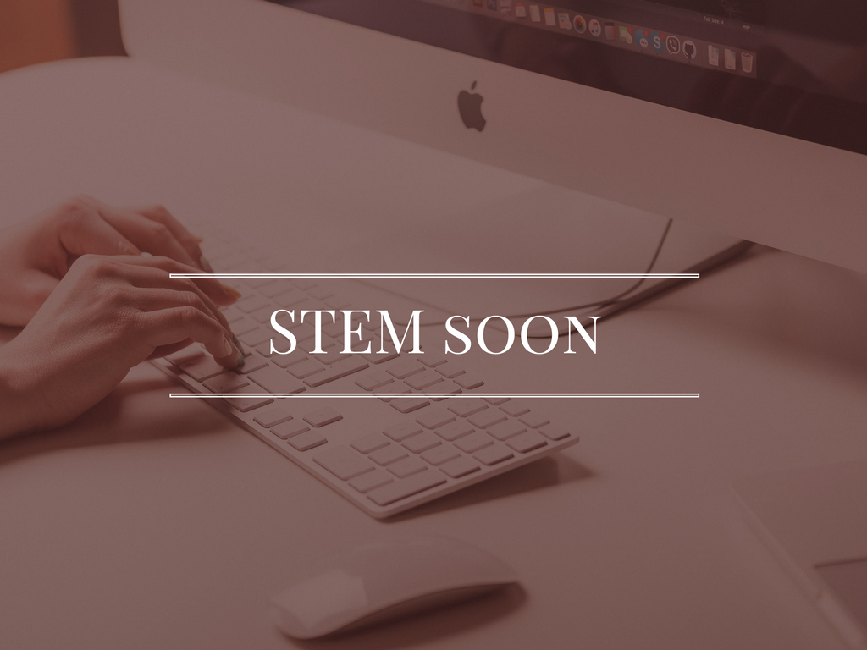
Notes:
So again, in 2006, these jobs didn’t even exist.
And are you sensing a theme in these? There’s very little mention of actual degrees or certifications.

Slide 16
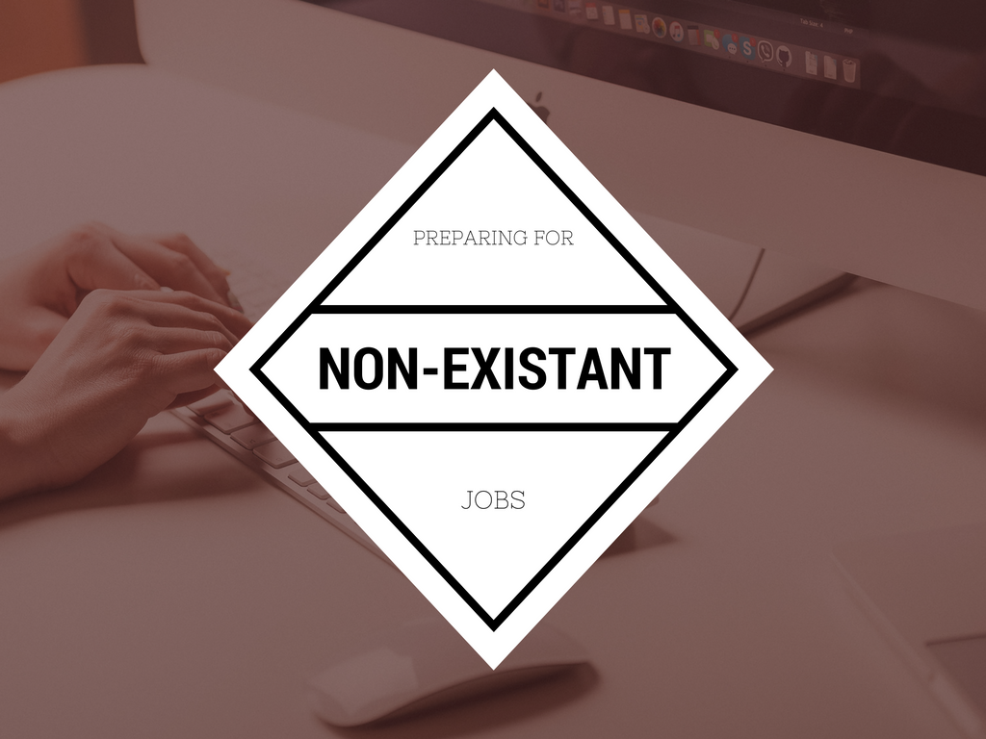
Notes:
Preparing for Non-Existant Jobs
So how do you prepare for jobs that won't exist when your children graduate?
How do know what to study if your degree itself might not even exist yet?

Slide 17

Notes:
Soft skills are becoming more and more desired by employers than pedigree or the kind of diploma. (http://www.telegram.com/article/20150215/NEWS/302169958)
What are "soft skills?" These are abilities that allow potential workers to be malleable, flexible, and deal with changes as they come up.
Employers still want experts, sure. But they're also just as interested in hiring folks who can write an email with a respectful tone of voice and proper grammar. They want employees who can seal a deal on a phone call or over a lunch.
Employers are also starting to put more emphasis on service, whether that's public or on campus, say. It shows that the potential employee not just cares about people but knows how to get along with them.

Slide 18
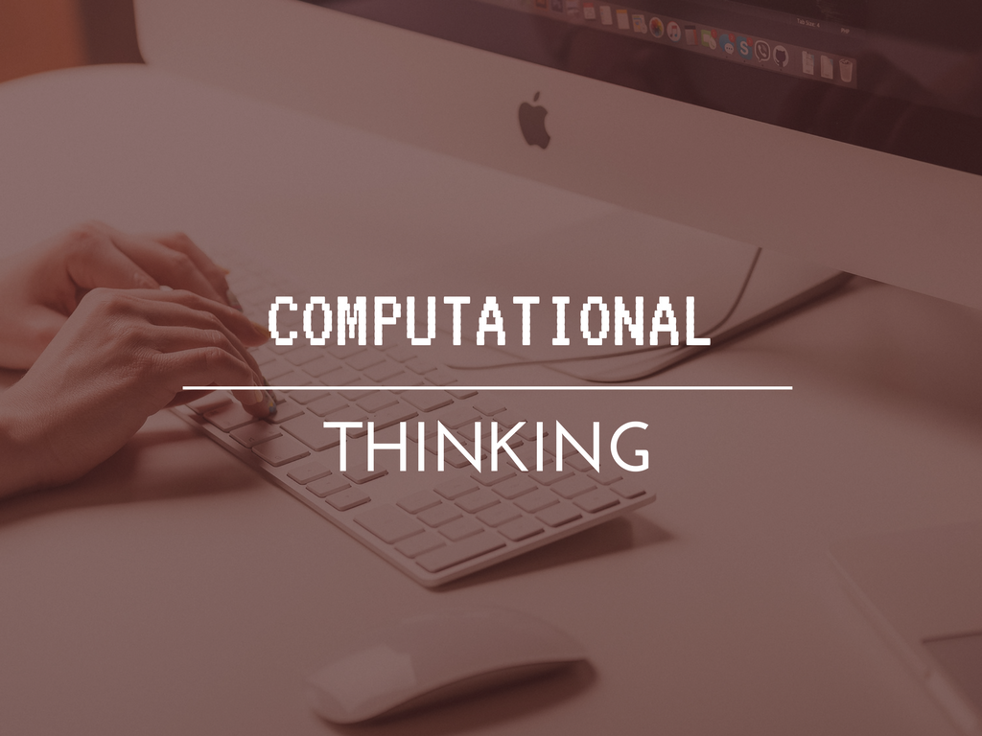
Notes:
Another skill they will want is computational thinking.
What is computational thinking? It's the kind of ability to manage biiiig amounts of data and spot patterns. It's essentially being able to tap into the thought process used by computers: logically organizing data, analyzing that data, and developing ordered steps to solving problems (like an algorithm).
Google for Education has a wonderful collection of materials, lessons, and videos on computational thinking

Slide 19
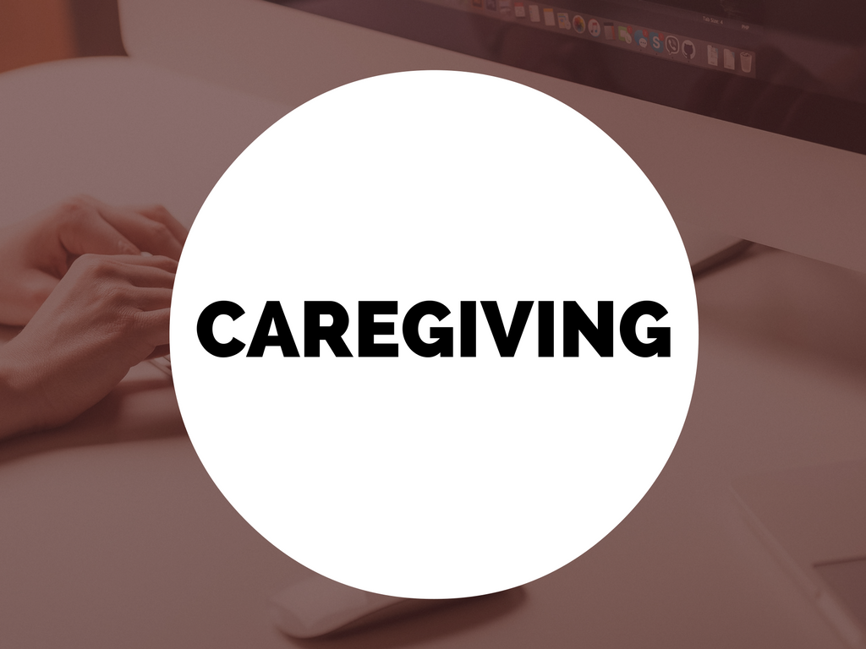
Notes:
Caregiving
You may be thinking, "what's caregiving got to do with STEM?"
Well, some of the fastest growing job sectors through 2025 will be fields like medical technician, physical therapist, workplace ergonomic experts, veteranarians, medical secretaries, and medical assistants. There is a health professional shortage like you would not believe and ... medicine falls in the S of STEM.

Slide 20
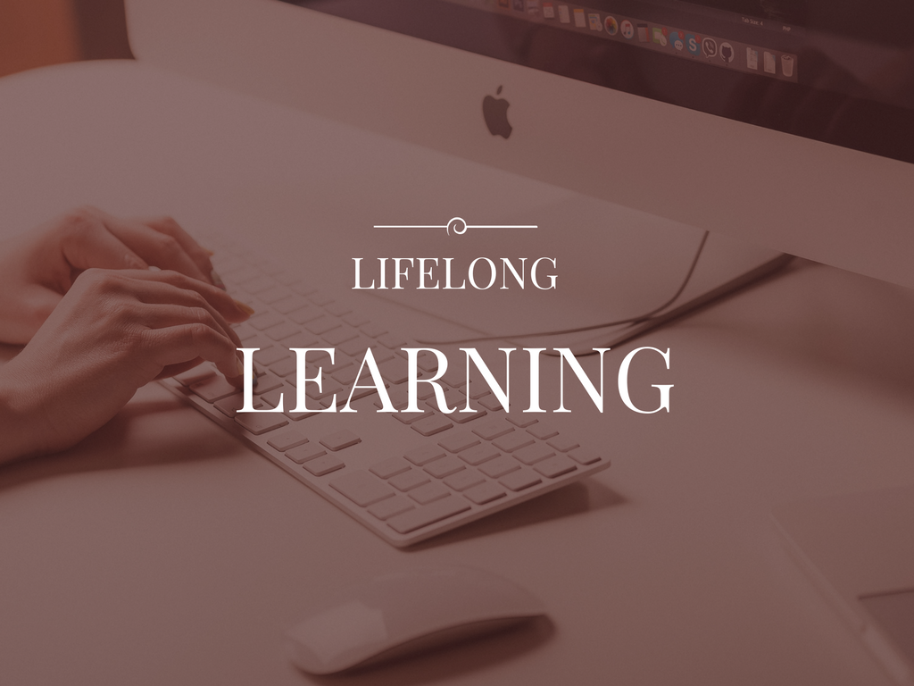
Notes:
This is more of a soft skill as opposed to a career, but I'm listing it for two reasons:
One: As demands change, so will job requirements. If you got a job by knowing C# but suddenly you find yourself needing to write large swaths of SQL code, you need the ability to not only likely teach yourself that code, but also know where to find those resources. To teaching students to have a certain level of auto-didacticism is incredibly important.
Two: we'll need people to teach those topics, as well, so teaching and training, especially, are two fields that always need new blood. In fact, the World Economic Forum lists teacher/trainer as number 6 on their list of growing sectors.

Slide 21

Notes:
So let's talk about some of the things you can do at home with your children that can both foster and support an interest in and love of these fields.
First up: some hardware

Slide 22
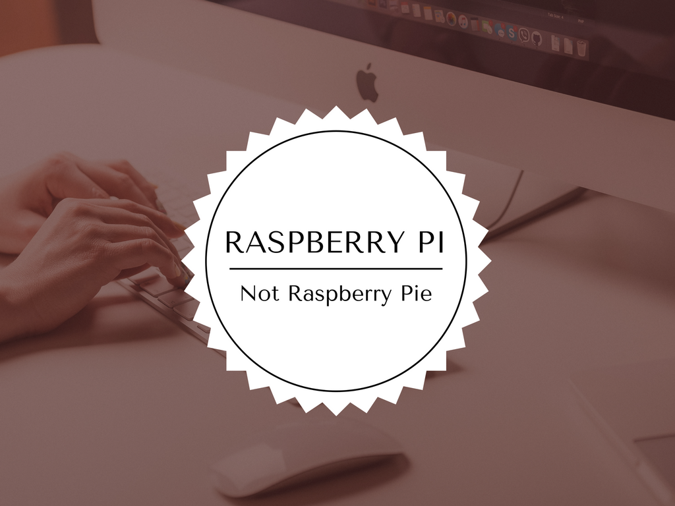
Notes:
Raspberry Pi
A tiny computer, basically, but much more powerful than you'd think just looking at its size. What could you do with this? What couldn't you do?
Here's a picture of a basic Raspberry Pi motherboard. (You'll need peripherals, of course.)
Create a rotoscope camera with your budding Fellini.
Make a "Retropie" together and play those classic games of your childhood.
Even make a face-tracking fan for the desk. They call it the FanBot.
You can pick up a Raspberry Pi for as low as $25 though kits range upwards of $100.
Really cool addition: there's a set of sensors you can pick up for $100 that extend the Pi's capabilities to anything from sensing flames to obstacle avoidance in moving machines to a photo-trip sensor. So cool.

Slide 23
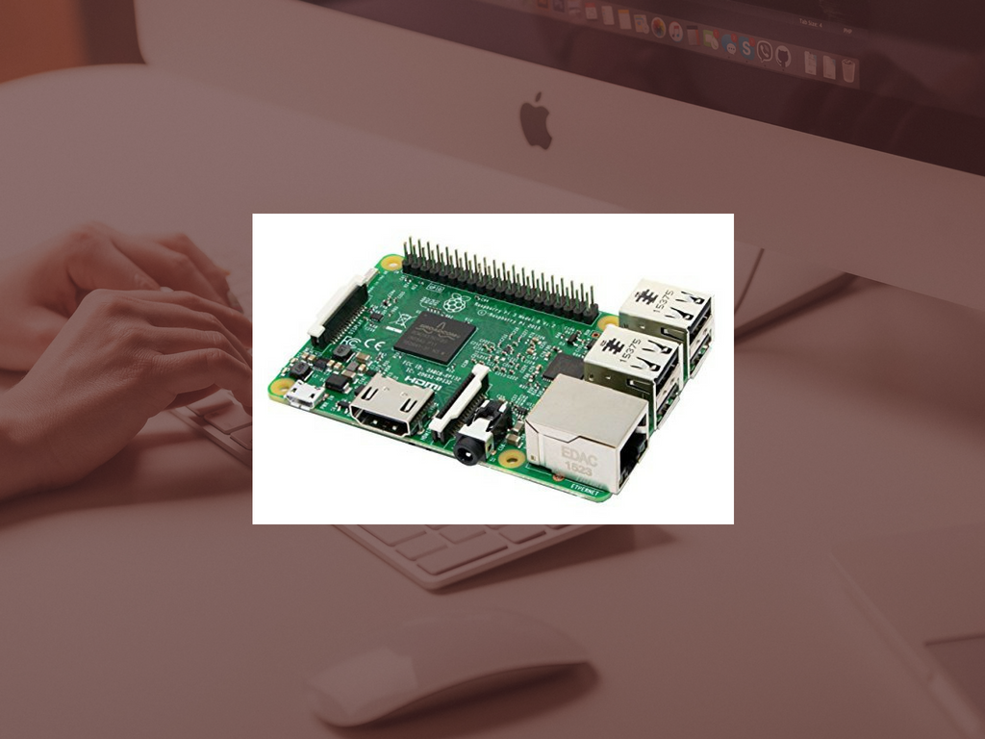
Notes:
Here's a picture of a basic Raspberry Pi motherboard. (You'll need peripherals, of course.)

Slide 24
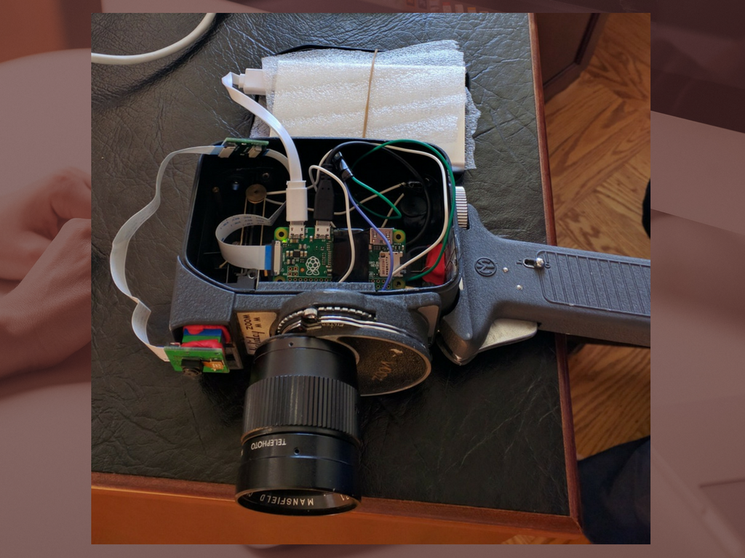
Notes:
Create a rotoscope camera with your budding Fellini.

Slide 25
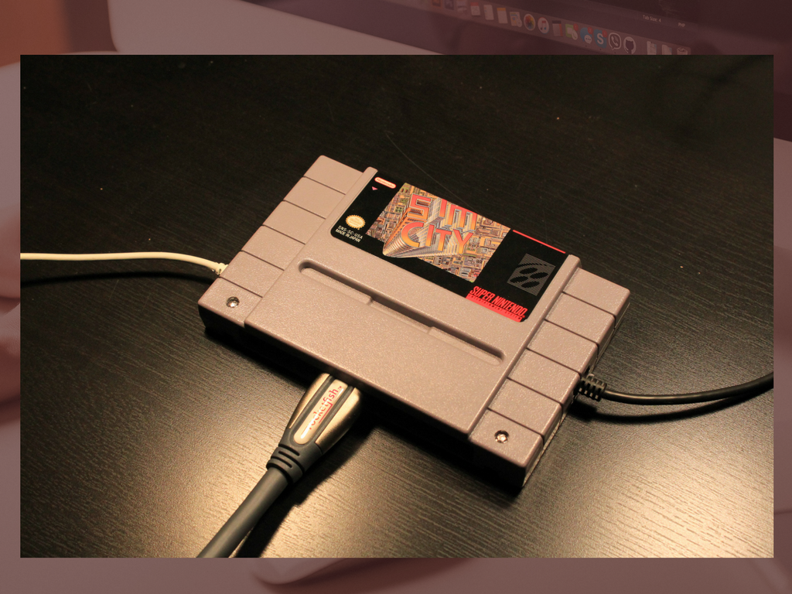
Notes:
Make a "Retropie" together and play those classic games of your childhood.

Slide 26
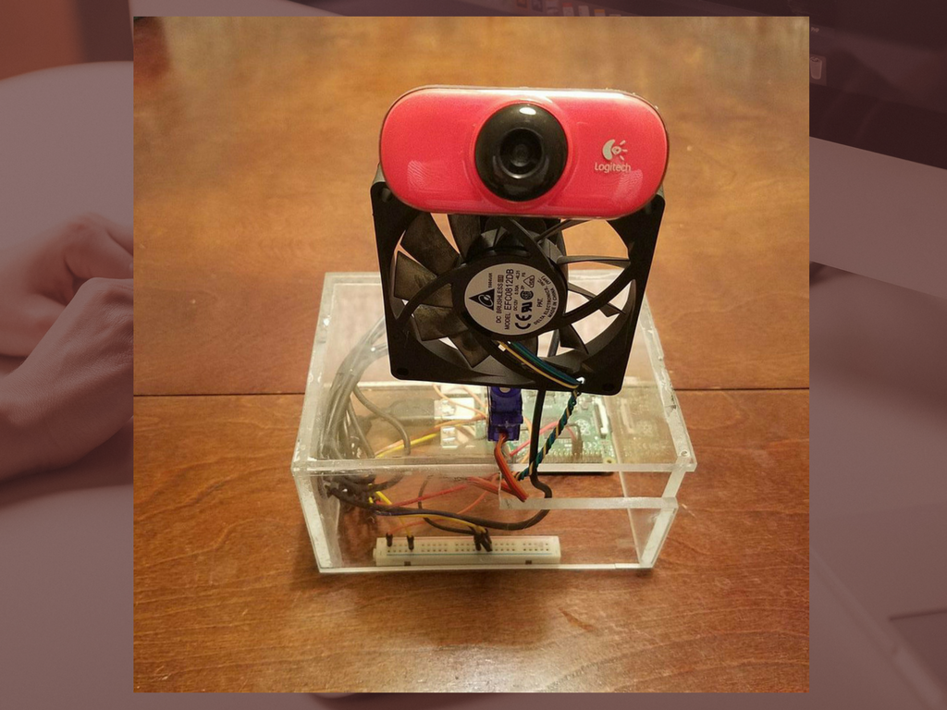
Notes:
Even make a face-tracking fan for the desk. They call it the FanBot.
You can pick up a Raspberry Pi for as low as $25 though kits range upwards of $100.
Really cool addition: there's a set of sensors you can pick up for $100 that extend the Pi's capabilities to anything from sensing flames to obstacle avoidance in moving machines to a photo-trip sensor. So cool.

Slide 27
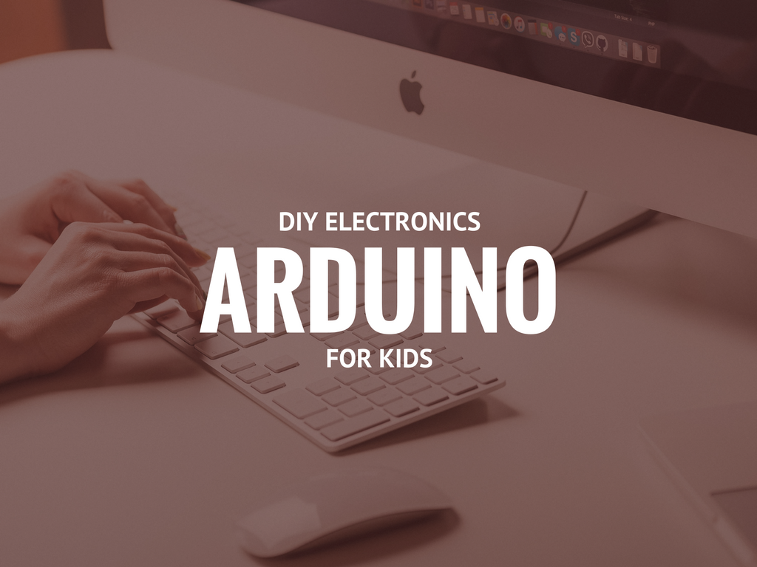
Notes:
If you've heard of Arduino, you've probably seen it used to do things like open and close doors or turn on sprinklers. It tends to be focused on electronics DIY enthusiasts for automating their home.
However, there's a lot kids can do with it.

Slide 28
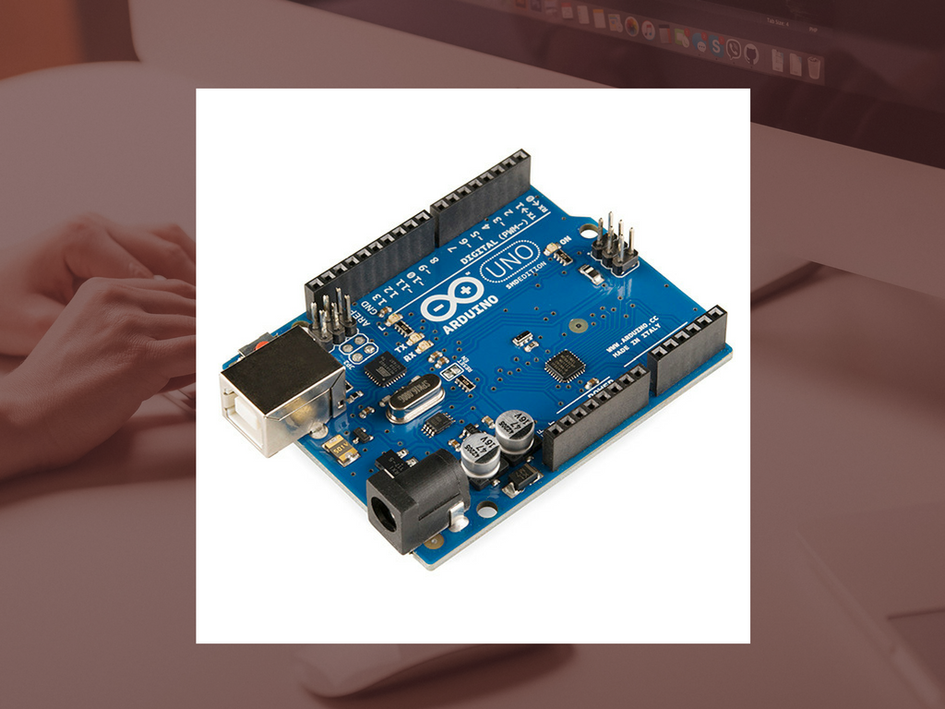
Notes:
First, what is it? They call it an "open-source electronics platform based on easy-to-use hardware and software... that's able to read inputs -- light on a sensor, a finger on a button, or a Twitter message -- and turn it into an output -- activating a monitor, turning on an LED, publishing something online."To use it, you program it using their language.
There's even a Scratch extension, but we'll get to Scratch in a bit.

Slide 29
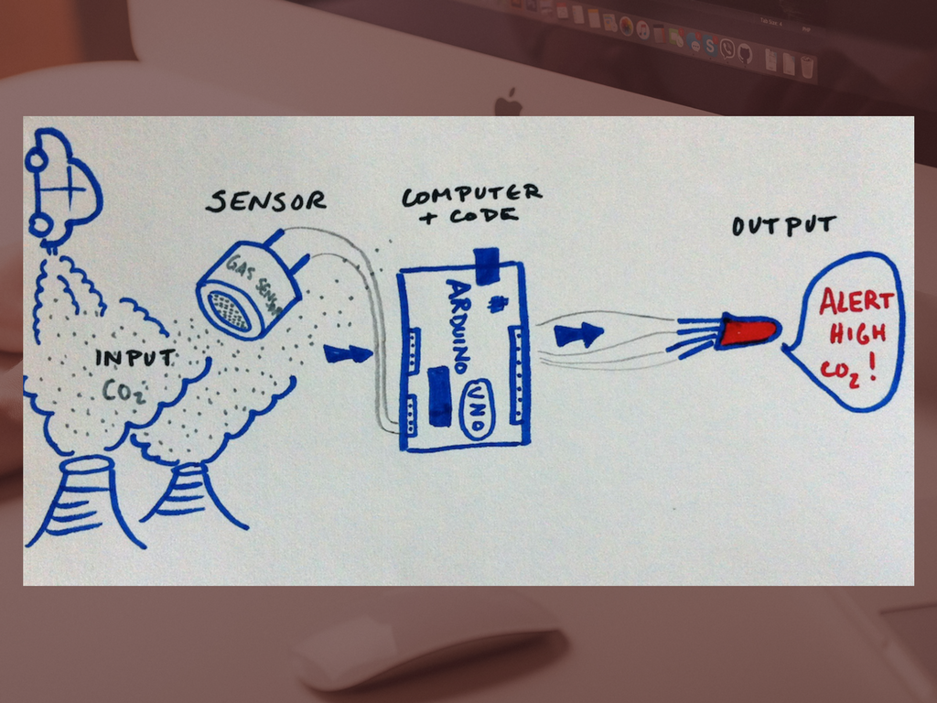
Notes:
So here’s an example of a CO2 detector made with Arduino.

Slide 30
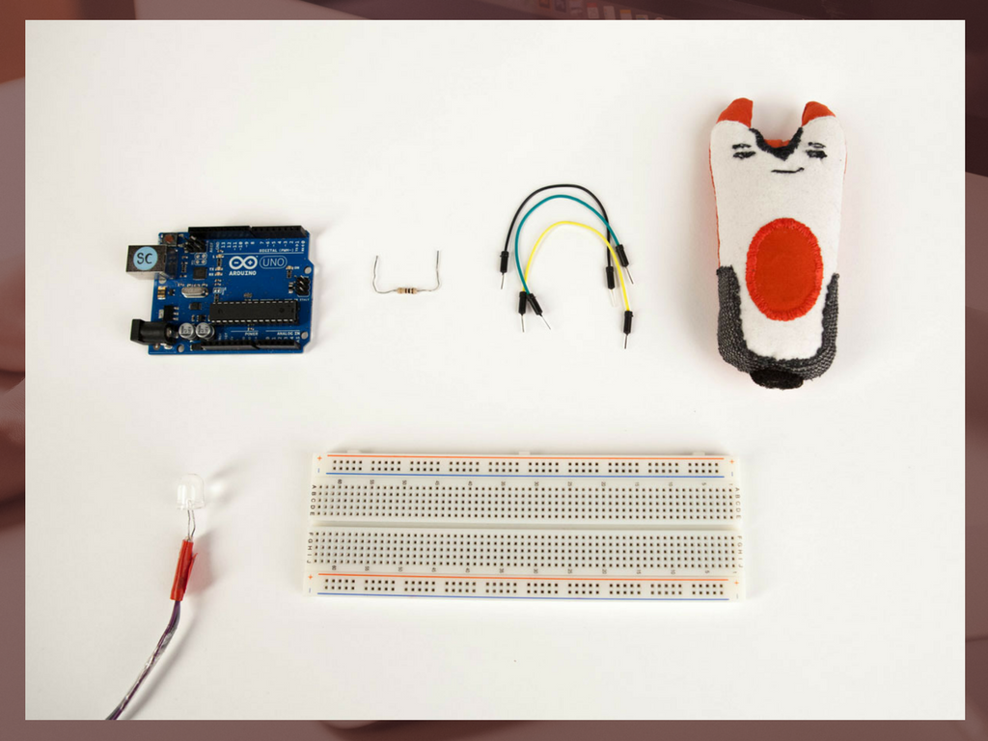
Notes:
You can see the Soft Puppet example here.
It lets parents and children create and share illustrated stories.
The parent records, say, some ideas for a story and some images.

Slide 31
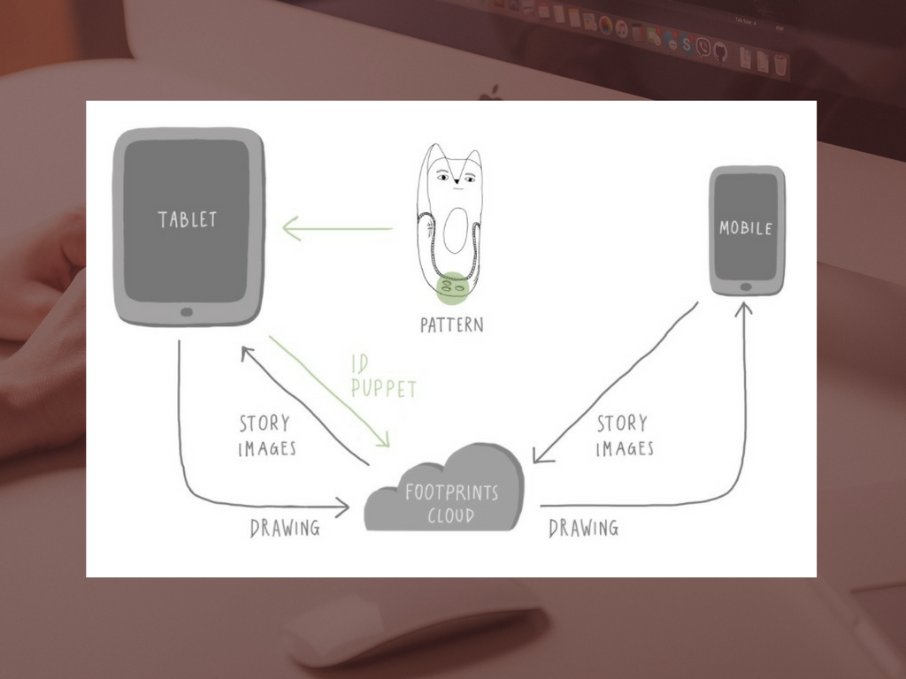
Notes:
This is transmitted to the puppet, which the child places on the tablet and then creates a story, making drawings and what-have-you using the app.
The completed story is then sent back tot he parent.
If there are any Neal Stephenson fans out there, I immediately thought of The Diamond Age and the Young Lady's Illustrated Primer when I saw this.

Slide 32
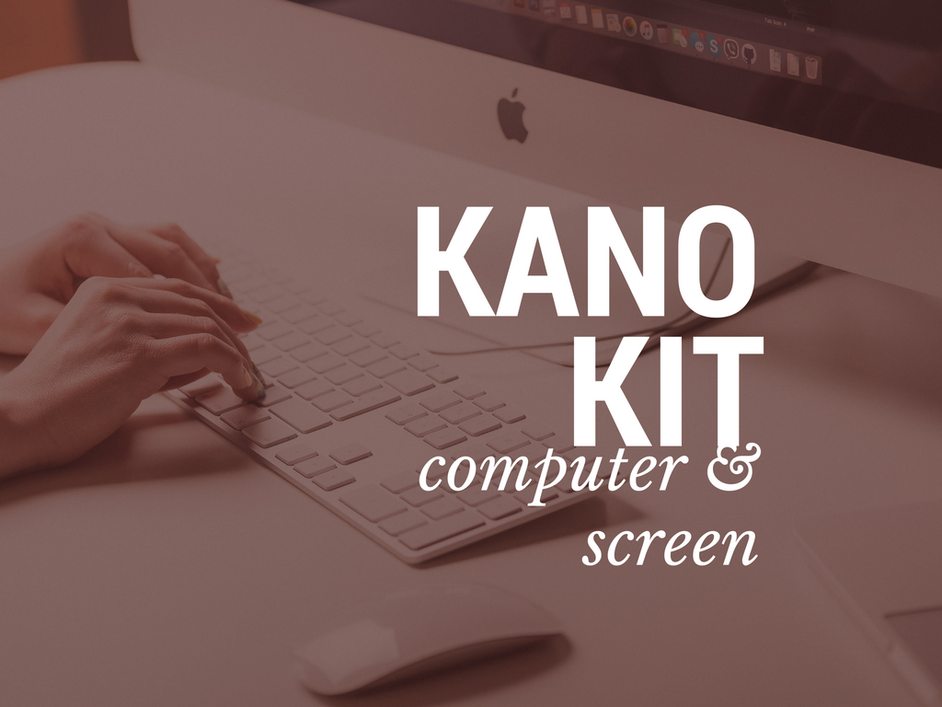
Notes:
Kano is a complete computer kit including a screen. Oh, and some assembly required.

Slide 33
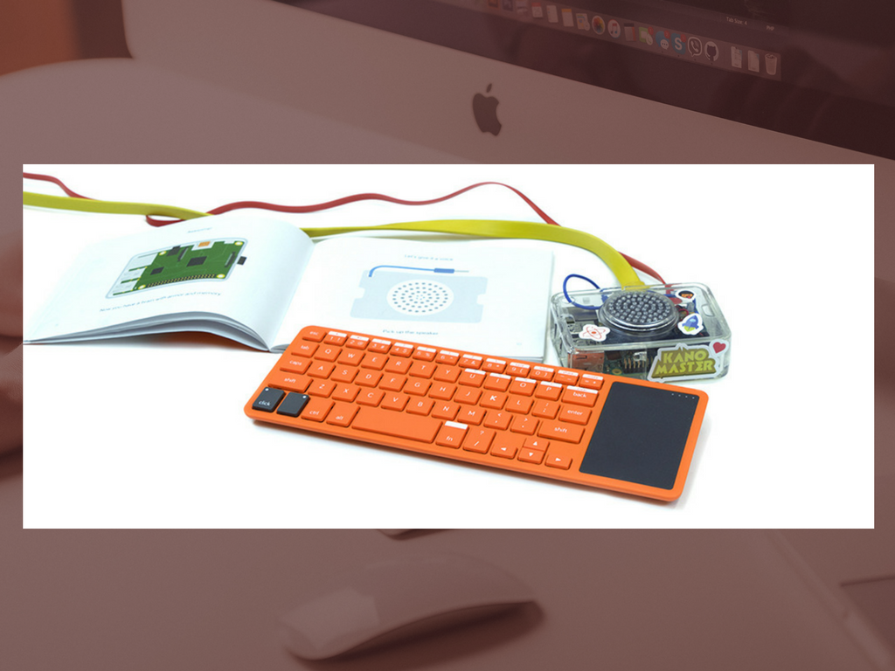
Notes:
Actually, the whole point is that you build the computer when you get it. It's modular.
It comes with a Raspberry Pi, a wireless keyboard, a "DIY" speaker, the case, an SD card to use as a harddrive, the power supply, an HDMI cable to attach it to the screen, and a book that acts as the instructions and build guide.
The screen should also be put together and comes with its own case, stand, power supply, cables, and even a magnifying glass they call "pixel viewer" so kids can see right up close while they're designing.
It's not cheap but it's pretty amazing.
Not just that, but there's a lot of material you can get from them, including an OS and software.
It goes so far as to teach coding skills! Both Python and JavaScript, used to create websites and games, respectively. Also teaches console commands and has a gamified teaching system so your kids can level up and get badges as they use the computer they built to learn to code.

Slide 34
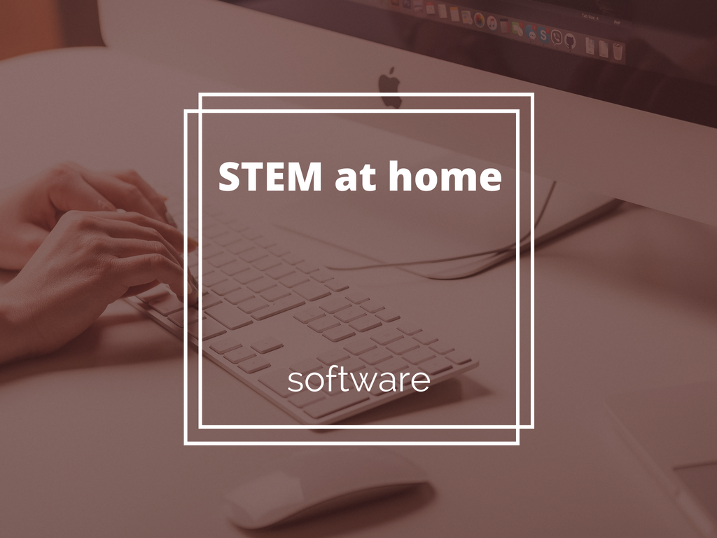
Notes:
Moving now from hardware to some software we can use with STEM.

Slide 35
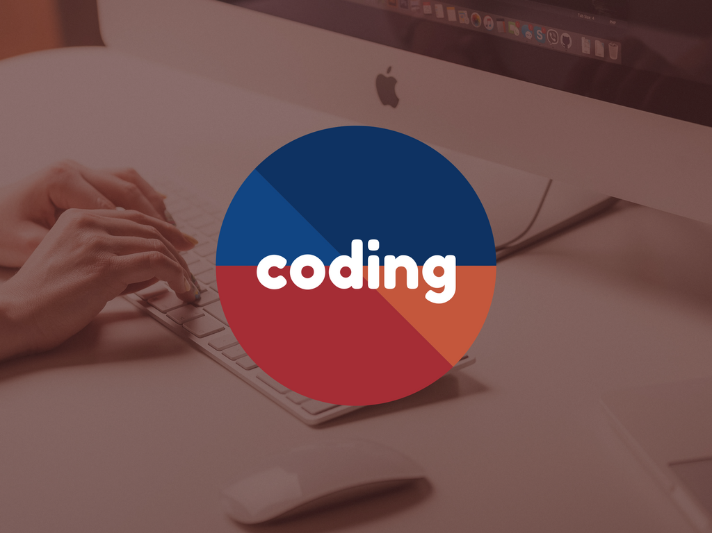
Notes:
Much of what's out there are websites now. So, I'd like to focus on one aspect of it (coding) and look at what's available.
Now Principal Travati has said there's a teacher here that's already using Code.org as an elective and that's phenomenal. I just want to share some other options that will give you as parents some flexibility in terms of your children's interests and relative skill levels.

Slide 36
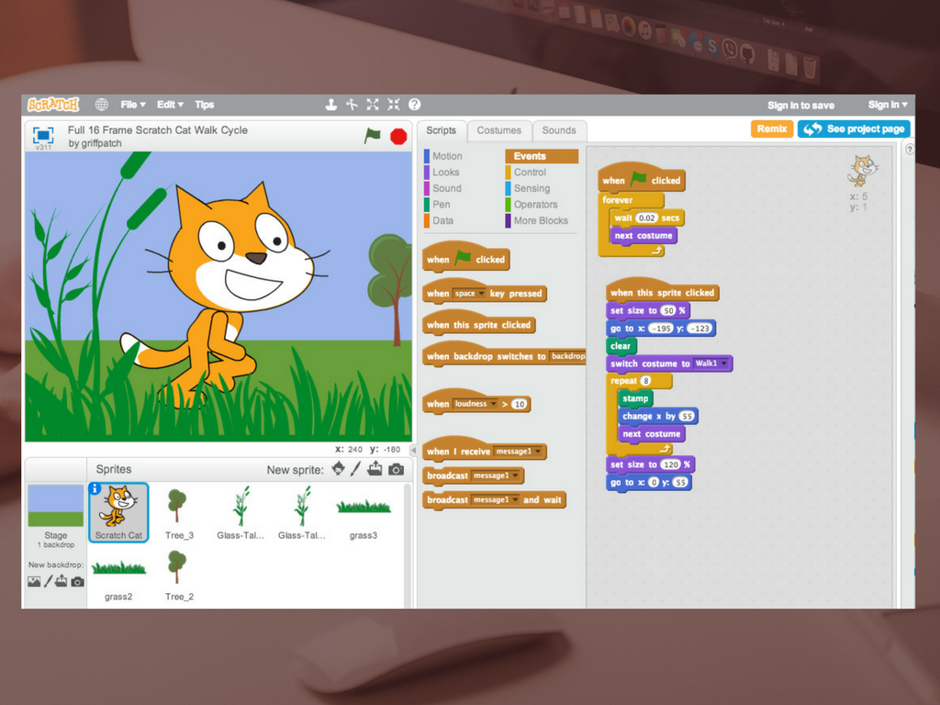
Notes:
Principal Taravati also mentioned that he's got some ideas for Scratch in the future, so I just want to mention it so as not to steal his thunder when it comes around.
In brief, Scratch is a visual programming language with a very robust online community. Kids create, share, and remix others' work.
Scratch can go a long way to setting up the cognitive foundations for that computational thinking we talked about earlier.

Slide 37
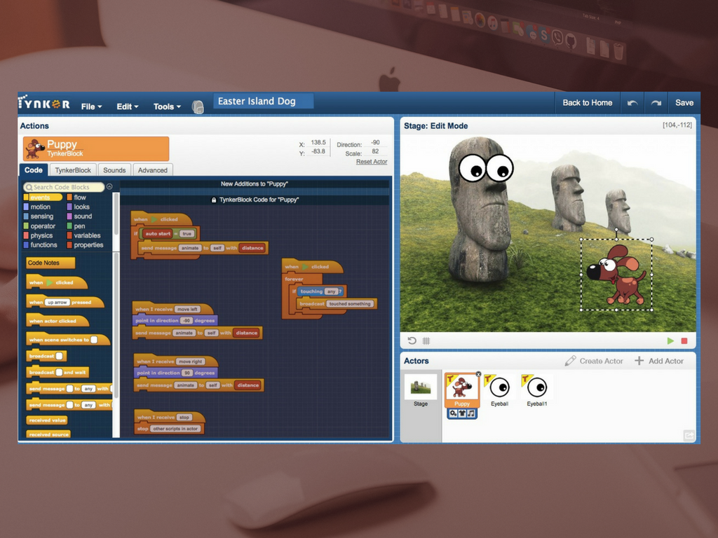
Notes:
Tynker is like Scratch but goes one further.
Anyone heard of MineCraft? Tynker is built so that you can actually create MineCraft mods.
And as you can see, it does look very familiar....

Slide 38
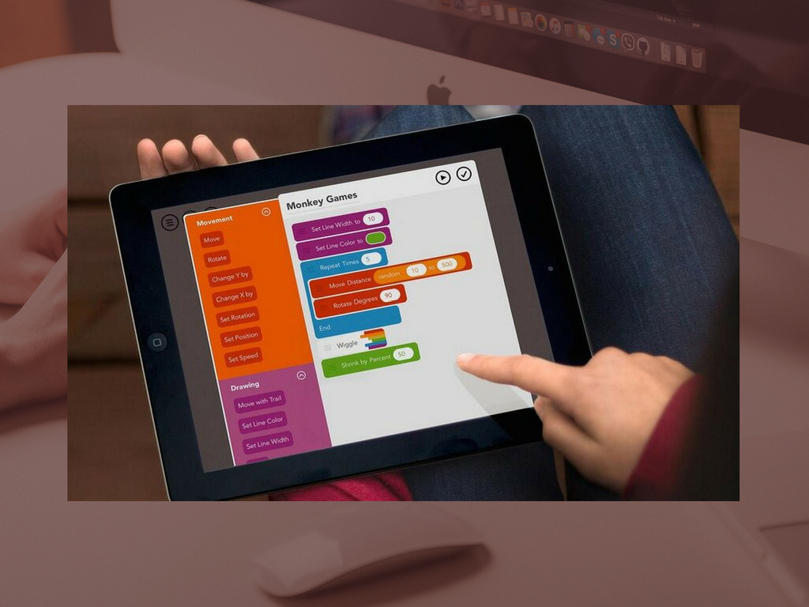
Notes:
For something on the iPhone and iPad, you can try Hopscotch.
And again, you're probably seeing some similarities...
Clearly, it's been found that using this sort of visual, modular coding methodology is a great way to teach children how to code without just plopping them down in front of a console and lecturing on the difference between variables and functions.
The technical term for this is "block-based programming."
Others that I won't get into right now are Code Studio, Blockly (the one used in Code.org), and Swift.

Slide 39
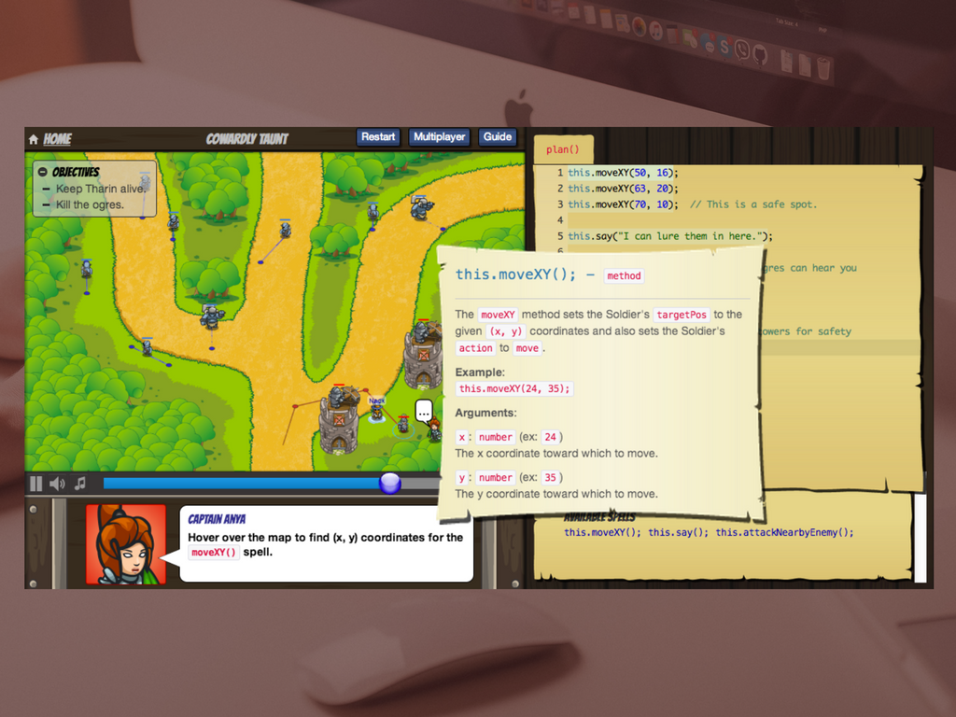
Notes:
CodeCombat is interesting because it's a mash-up of game development and coding education that teaches you as you, essentially, build the games and direct the action.
For example, as in the slide, in order to move your character around the screen, you have to use the "moveXY" function and set the coordinates.
Players/coders can create teams and work together in a variety of different scenarios.
Unlike the ones mentioned previously, CodeCombat uses languages that aren't visual. These include:
Python, JavaScript, CoffeeScript, Clojure, Lua, Io
Also has courses on HTML5, CSS3, Bootstrap
Lots of school integration, too, with resources for teachers and students, alike.

Slide 40
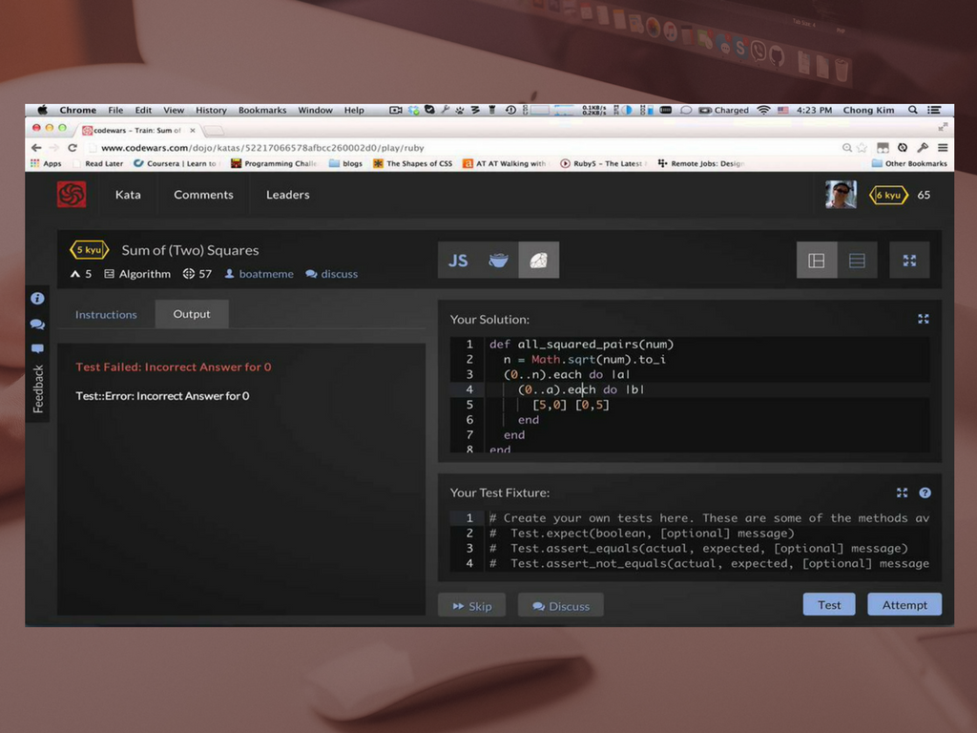
Notes:
Codewars is a bit more advanced and is there more to hone skills than to teach them.
It works by challenging users with small coding tests called "kata," a reference to choreographed movements in martial arts. Why? Because the point of the different kata in Codewars is to find the best practice or most efficient way of accomplishing the tasks set in front of you.
That is, users are given tasks to complete. They're given a description, some input data, and the output data. The user then needs to fill in (or correct) the middle to get from input to output in the best way.
Users can also create their own tests.
The community votes on different solutions to the problems (and there are many), which users can then go in and see, helping with their own coding tasks.
Languages included in Codewars include Clojure, CoffeeScript, C++, C#, Elixir, Java, JavaScript, Haskell, PHP, Python, Ruby, and TypeScript, with others coming.

Slide 41
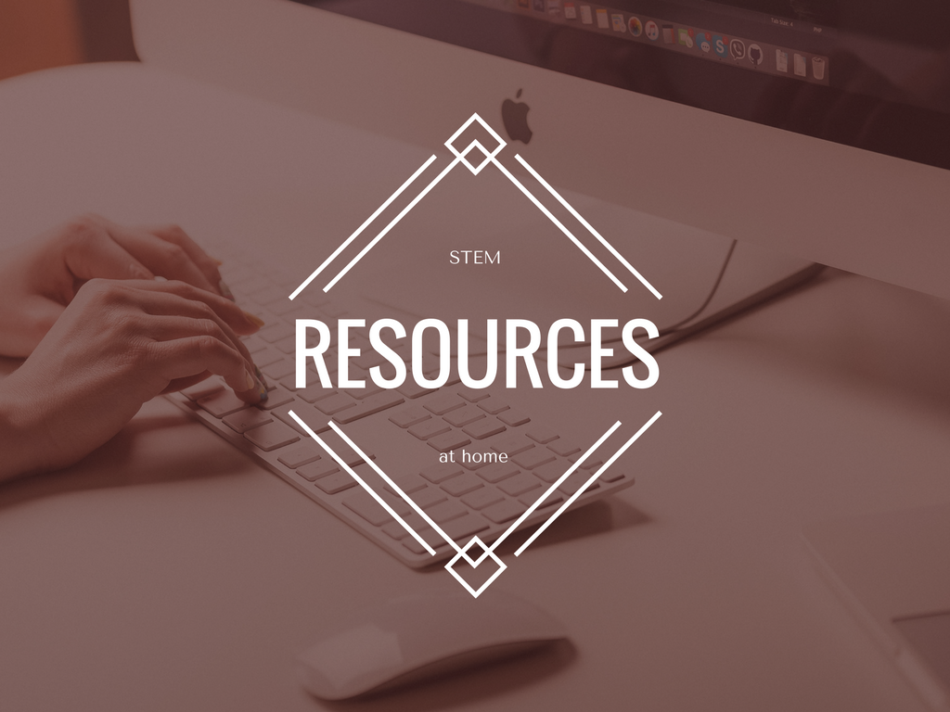
Notes:
Now there are lots of resources out there (just google "stem activities" and you'll be busy for weeks just sorting through this stuff) and I'll give Principal Taravati a list that he can forward on to the parents. I just want to highlight a few that I think are worth exhibiting.

Slide 42
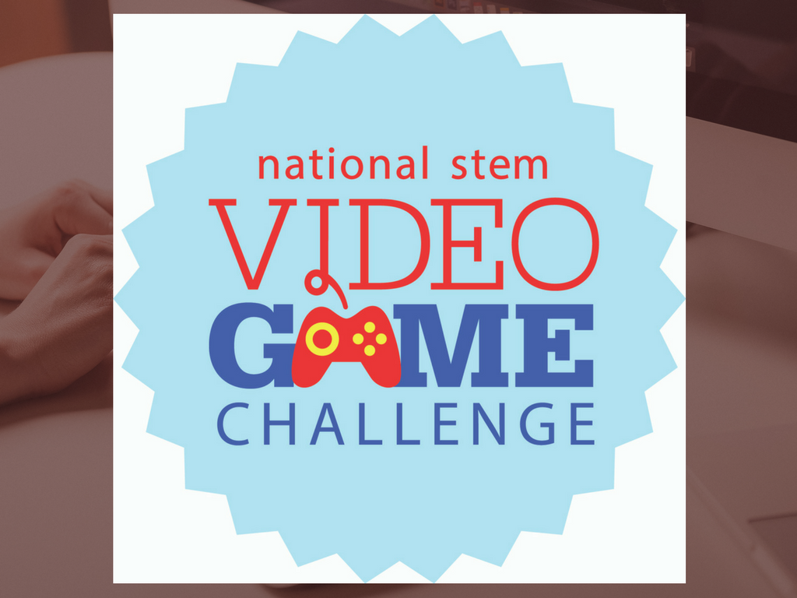
Notes:
National STEM Video Game Challenge
This is a tremendously popular and amazing contest that's held every year (unfortunately, this year's deadline was August 15th, so we just missed it).
The National STEM Video Game Challenge gets students together to design OR develop games. That is, they don't actually just have to code or draw anything, and could in fact simply just design the game on paper.
I have a book here called Challenges for Game Designers that's a great resource for anyone who'd like to help their children hone the game mechanic thinking as all the challenges are for things like board games or card games. No coding necessary.
The 2015 winner of the STEM challenge got to go to the 2016 White House Science Fair and I don't need to tell you how that looks on a college application.
So, think of this as a big goal that you and your children can work toward.

Slide 43

Notes:
Books
Speaking of books, I think it's important to remember that not every great STEM resource has to be a website or a game.
For example, the Manga Guide to Physics is a great resource.
(Manga, for those who don't know, are Japanese comic books and graphic novels, usually with a style that's easy to distinguish from "Western" comics; manga is to comic book as anime is to cartoon)
But it's not just the guide to physics... there's also Manga guides to
Statistics
Databases
Electricity
Calculus
Molecular biology
Relativity
The Universe
Biochemistry
Linear Algebra
I have an ebook copy of the Linear Algebra guide if anyone wants to come take a look.

Slide 44
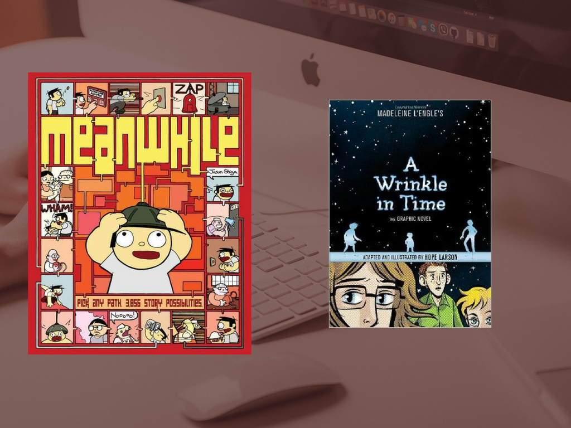
Notes:
In addition to those, there are other graphic novels likeA Wrinkle in Time (i'm sure some of you remember that)
Meanwhile (a choose-your-own-adventure book about math... that's way more enjoyable than it sounds)
Trinity: A Graphic History of the First Atomic Bomb (which would be appropriate for older students, I think)

Slide 45
Notes:
And that's all!
Again, I will have Principal Taravati get you a list of some (vetted) resources and collections of activities that you can plan to do on weekends or during school breaks.
Thank you!

